Slide 1
Circumlocution Traits
to Describe Items
Aphasia-friendly toolkit Feb 2024
Disclaimer: These materials were created using funding from the Provincial Community Stroke Rehabilitation Initiative and crafted by Aran Oberle, Speech Language Pathologist, with input from regional rehab programs. They are not meant to replace professional expertise. Readers should seek advice from a qualified healthcare provider for any concerns. The content of this PowerPoint can be adjusted to suit the needs of healthcare professionals. Users are accountable for confirming the accuracy and suitability of the information for their unique situations.​

Slide 2
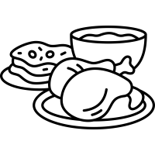
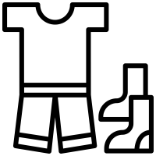
What type?
Animal
Food
Furniture
Place
Tool
Sport
Clothing
Other

Slide 3
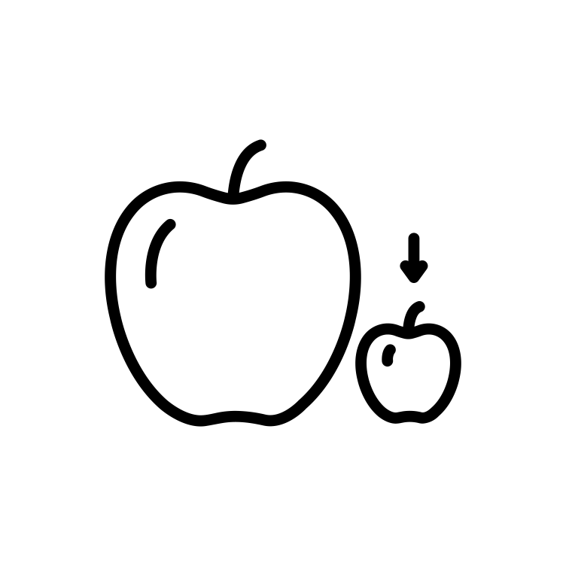
What shape?
Round
Flat
Rectangular
Triangular
Long
Short
Other

Slide 4
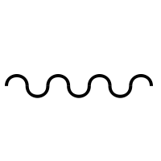
What texture?
Rough
Smooth
Soft
Hard
Fluffy/fuzzy
Sharp
Prickly
Bumpy
9. Other

Slide 5
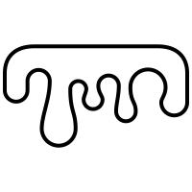
What texture?
Rubbery
Gritty
Wrinkly
Wet
Dry
Slimy
Other

Slide 6
What Colour?
Black
White
Red
Yellow
Blue
Green
Purple
Other

Slide 7
What Colour?
Orange
Pink
Gray
Brown
Gold
Silver
Bronze
Other

Slide 8
What size?
Bigger than a dog
Smaller than a dog
Bigger than a horse
Smaller than a horse
Other

Slide 9
What size?
Bigger than a microwave
Smaller than a microwave
Bigger than a house
Smaller than a house
Other

Slide 10
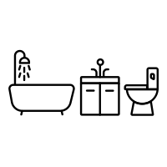
Where is it?
Inside
Outside
Living room
Bathroom
Kitchen
Grocery Store
Shopping Mall
Other

Slide 11
Where is it?
School
Office
Road
Forest
Zoo
City
Sky
Other

Slide 12
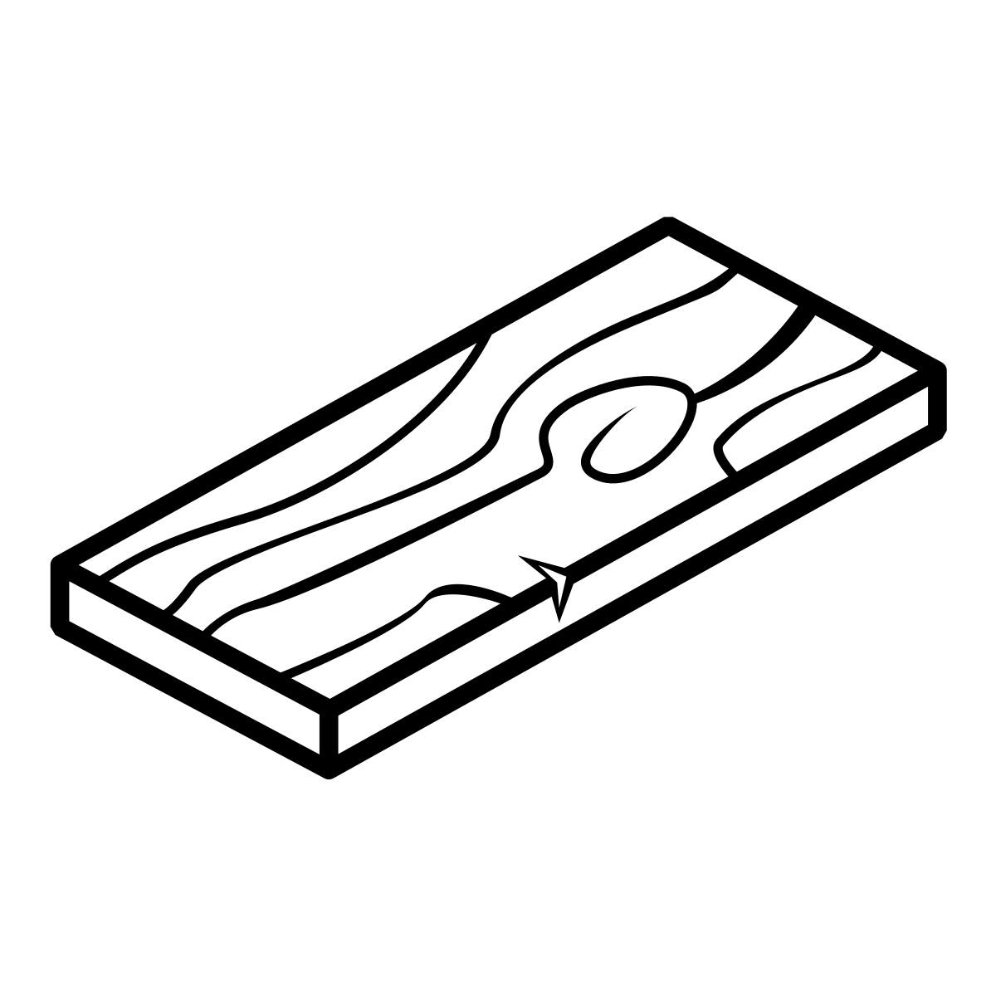
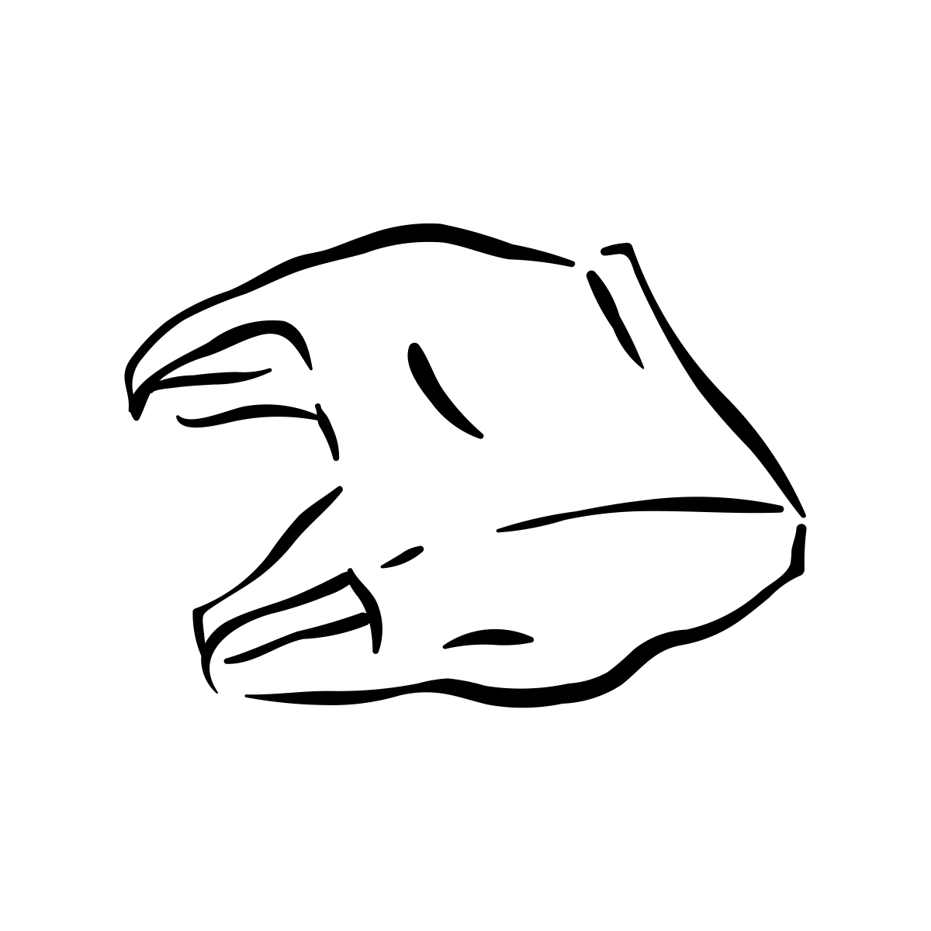
What is it made of?
Metal
Wood
Rubber
Cloth
Plastic
Glass
Paper
Other

Slide 13
Quel genre?
Animal
Nourriture
Meuble
Endroit
Outil
Sport
Vêtement
Autre

Slide 14
Quelle forme?
Rond
Plat
Rectangulaire
Triangulaire
Long
Court
Autre

Slide 15
Quelle texture?
Rugueux
Lisse
Doux
Dur
Pelucheux
Pointu
Piquant
Bosselé
9. Autre

Slide 16
Quelle texture?
Caoutchouc
Graveleux
Ridée
Mouillé
Sec
Gluant
Autre

Slide 17
Quelle taille?
Plus grand qu'un chien
Plus petit qu'un chien
Plus grand qu'un cheval
Plus petit qu'un cheval
Autre

Slide 18
Quelle taille?
Plus grand qu'un micro-ondes
Plus petit qu'un micro-ondes
Plus grand qu'une maison
Plus petit qu'une maison
Autre

Slide 19
Quelle Couleur?
Noir
Blanc
Rouge
Jaune
Bleu
Vert
Violet
Autre

Slide 20
Quelle Couleur?
Orange
Rose
Gris
Brun
Or
Argent
Bronze
Autre

Slide 21
Où est-il?
Intérieur
Extérieur
Salon
Salle de bain
Cuisine
Épicerie
Centre Commercial
Autre

Slide 22
Où est-il?
École
Bureau
Rue
Forêt
Zoo
Ville
Ciel
Autre

Slide 23
C'est fait en quoi?
Métal
Bois
Caoutchouc
Tissu
Plastique
Verre
Papier
Autre

