Slide 1
Warning Signs
of Heart Attack
Aphasia-friendly toolkit Feb 2024
Disclaimer: These materials were created using funding from the Provincial Community Stroke Rehabilitation Initiative and crafted by Aran Oberle, Speech Language Pathologist, with input from regional rehab programs. They are not meant to replace professional expertise. Readers should seek advice from a qualified healthcare provider for any concerns. The content of this PowerPoint can be adjusted to suit the needs of healthcare professionals. Users are accountable for confirming the accuracy and suitability of the information for their unique situations.

Slide 2
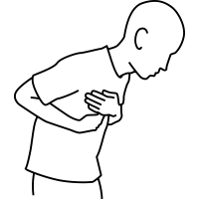
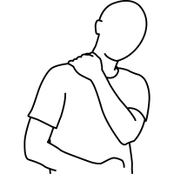
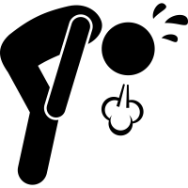
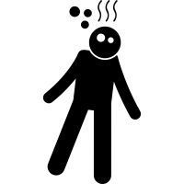
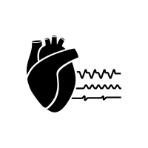
STOP immediately and get medical help if you feel:
Chest pain or pressure
Jaw/neck pain
Arm pain
Shoulder/back pain
Short of breath
Dizzy
Light-headed
Irregular heart rate
Adapted from: Heart attack. National Heart, Lung, and Blood Institute. https://www.nhlbi.nih.gov/health/heart-attack/causes. Accessed March 20, 2023.

Slide 3
ARRÊTER et chercher de l'aide médicale immédiate
si vous avez:
Douleurs ou pression au niveau de la poitrine
Douleur à la machoire ou au cou
Douleur au long du bras
Douleur traversant la poitrine et le dos
L'essoufflement inhabituel
Étourdissements
Rhythme cardiaque irrégulier
Adapté de: Heart attack. National Heart, Lung, and Blood Institute. https://www.nhlbi.nih.gov/health/heart-attack/causes. Accessed March 20, 2023.

